Slide 1
Module 2:
Objects in VBScript and WSH

Slide 2

Overview
Object Terminology
Creating and Manipulating Objects
Object Models
Common Object Models

Slide 3
Lesson 1: Object Terminology
Object Terminology Definitions
Methods and Properties
Instantiation Terminology

Slide 4
Object Terminology Definitions
Objects
  Packaged functionality
Compiled Objects

Slide 5
Methods and Properties
Methods
Invoking a method
Using parentheses
Properties

Slide 6
Instantiation Terminology
Classes
  Blueprints for your objects
An Analogy—Architect Drawings and Buildings
Type Libraries
  A collection of classes
Instantiation
  Multiple instances

Slide 7
Lesson 2: Creating and Manipulating Objects
Creating Objects
Manipulating Objects

Slide 8
Creating Objects
Libraries
  Example—Wshom.ocx
Classes
  Example—WScript.Network
Example of Object Usage
Dim oNetwork
Set oNetwork = CreateObject(“WScript.Network”)
oNetwork.MapNetworkDrive "z:", "\\London\Lab2Share"

Slide 9
Manipulating Objects
Assigning an Object to a Variable
Manipulating an Object
Deleting an Object
Set objFSO = CreateObject("Scripting.FileSystemObject")
objFSO.CreateFolder("C:\Test")
Set objFSO = Nothing

Slide 10
Lesson 3: Object Models
Defining Object Models
COM Objects
COM Objects in Practice
Custom COM Components
Viewing Object Models by Using an Object Browser
Demonstration: Viewing Object Models by Using an Object Browser
The Scripting Object Model
The WSH Object Model

Slide 11
Defining Object Models
Describing Object Models
Examples of Object Models
  WSH
  ADSI
  ADO
  WMI

Slide 12
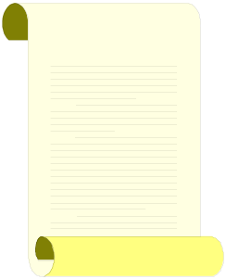
COM Objects
WScript
Data Marshalling
Contract
What Can You Do?
This Is What I Can Do...
VBScript

Slide 13
COM Objects in Practice
Object Identification
  ProgID
Automation
  Required for script
Type Libraries
  Defines component's metadata

Slide 14
Custom COM Components
COM Component Basics
  Customized pieces of functionality
  Use in the same way as standard COM objects
  Support Automation and handle data types
Registering COM Components
  Required to access component from scripts

Slide 15
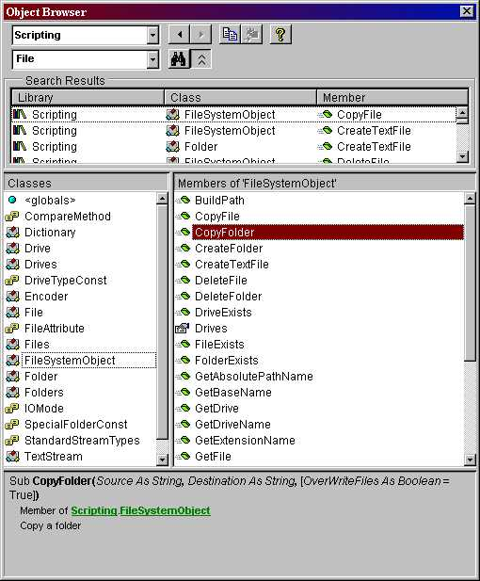
Viewing Object Models by Using an Object Browser
Accessing Type Libraries
Reviewing Class Information

Slide 16

Demonstration: Viewing Object Models by Using an Object Browser
In this demonstration, you will see how to:
Use an object browser to view an object model
Add the Scripting library

Slide 17
The Scripting Object Model
FileSystemObject
Drives
Drive
Dictionary
Folders
Folder
Files
Encoder
File
TextStream

Slide 18
The WSH Object Model
WScript
Arguments
Shell
SpecialFolders
Shortcut
UrlShortcut
Environment
Network
= Intrinsic Object

Slide 19
Lesson 4: Common Object Models
CDO
ADO
ADSI
WMI
Microsoft Office
Internet Explorer and IIS
Other Applications

Slide 20
CDO
CDO Names
CDO Library Versions

Slide 21
ADO
Data Sources
Examples of Database Providers:
  ODBC
  SQL Server
  Active Directory directory service
  Exchange 2007

Slide 22
ADSI
Active Directory Service Interfaces
Gives Access to Multiple Directory Service Providers Through an Open Set of Interfaces
ADSI Providers Include:
  LDAP
  Windows NT
  NDS
  NetWare 3 bindery

Slide 23
WMI
Web-Based Enterprise Management
  Standard management API
WMI
  Can monitor and configure the Windows operating system, system devices, Active Directory, the registry, performance counters, and so on
  Execute methods on managed objects
  Receive event notifications

Slide 24
The Microsoft Office System
Scripting in Microsoft Office
  Microsoft Word, Microsoft Excel, Microsoft PowerPoint, Microsoft Access, Microsoft Outlook, and Microsoft FrontPage
Example of Scripting Office Excel
  Create an Application object
  Open a Workbook object
Set oExcelApp = CreateObject("Excel.Application")
Set oWorkbook = oExcelApp.Workbooks.Open("C:\User.xls")

Slide 25
Internet Explorer and IIS
Internet Explorer
  Script host
  No access to WSH
IIS
  Use scripts to administer IIS
ASP
  Web-based scripting
  Runs on IIS server

Slide 26
Other Applications
Utilities
  Example: Windows Media Player

Slide 27

Lab: Objects in VBScript and WSH
Exercise 1
Manipulating the Scripting Object Model
Exercise 2
Manipulating the WSH Object Model
Exercise 3
Automating Microsoft Office Word

